Slide 1

Customer Shopping Behavior Analysis
Analyzing transactional data to uncover insights into spending patterns, customer segments, and product preferences.

Slide 2

Project Overview
1
2
Data Analysis
Key Insights
3,900 purchases analyzed.
Spending patterns, customer segments, product preferences.
3
Strategic Goals
Guide business decisions.

Slide 3


Dataset Summary
Data Points
Rows: 3,900
Columns: 18
Key Features
Customer demographics (Age, Gender, Location, Subscription)
Purchase details (Item, Category, Amount, Season, Size, Color)
Shopping behavior (Discount, Promo, Previous Purchases, Frequency, Review, Shipping)
Missing Data: 37 values in Review Rating column.

Slide 4
Exploratory Data Analysis (Python)
01
02
03
Data Loading & Exploration
Data Cleaning
Column Standardization
Imported with pandas, checked structure and summary statistics.
Imputed missing Review Rating values using median.
Renamed columns to snake_case.
04
05
Feature Engineering
Database Integration
Created age_group and purchase_frequency_days.
Loaded cleaned data into PostgreSQL for SQL analysis.

Slide 5
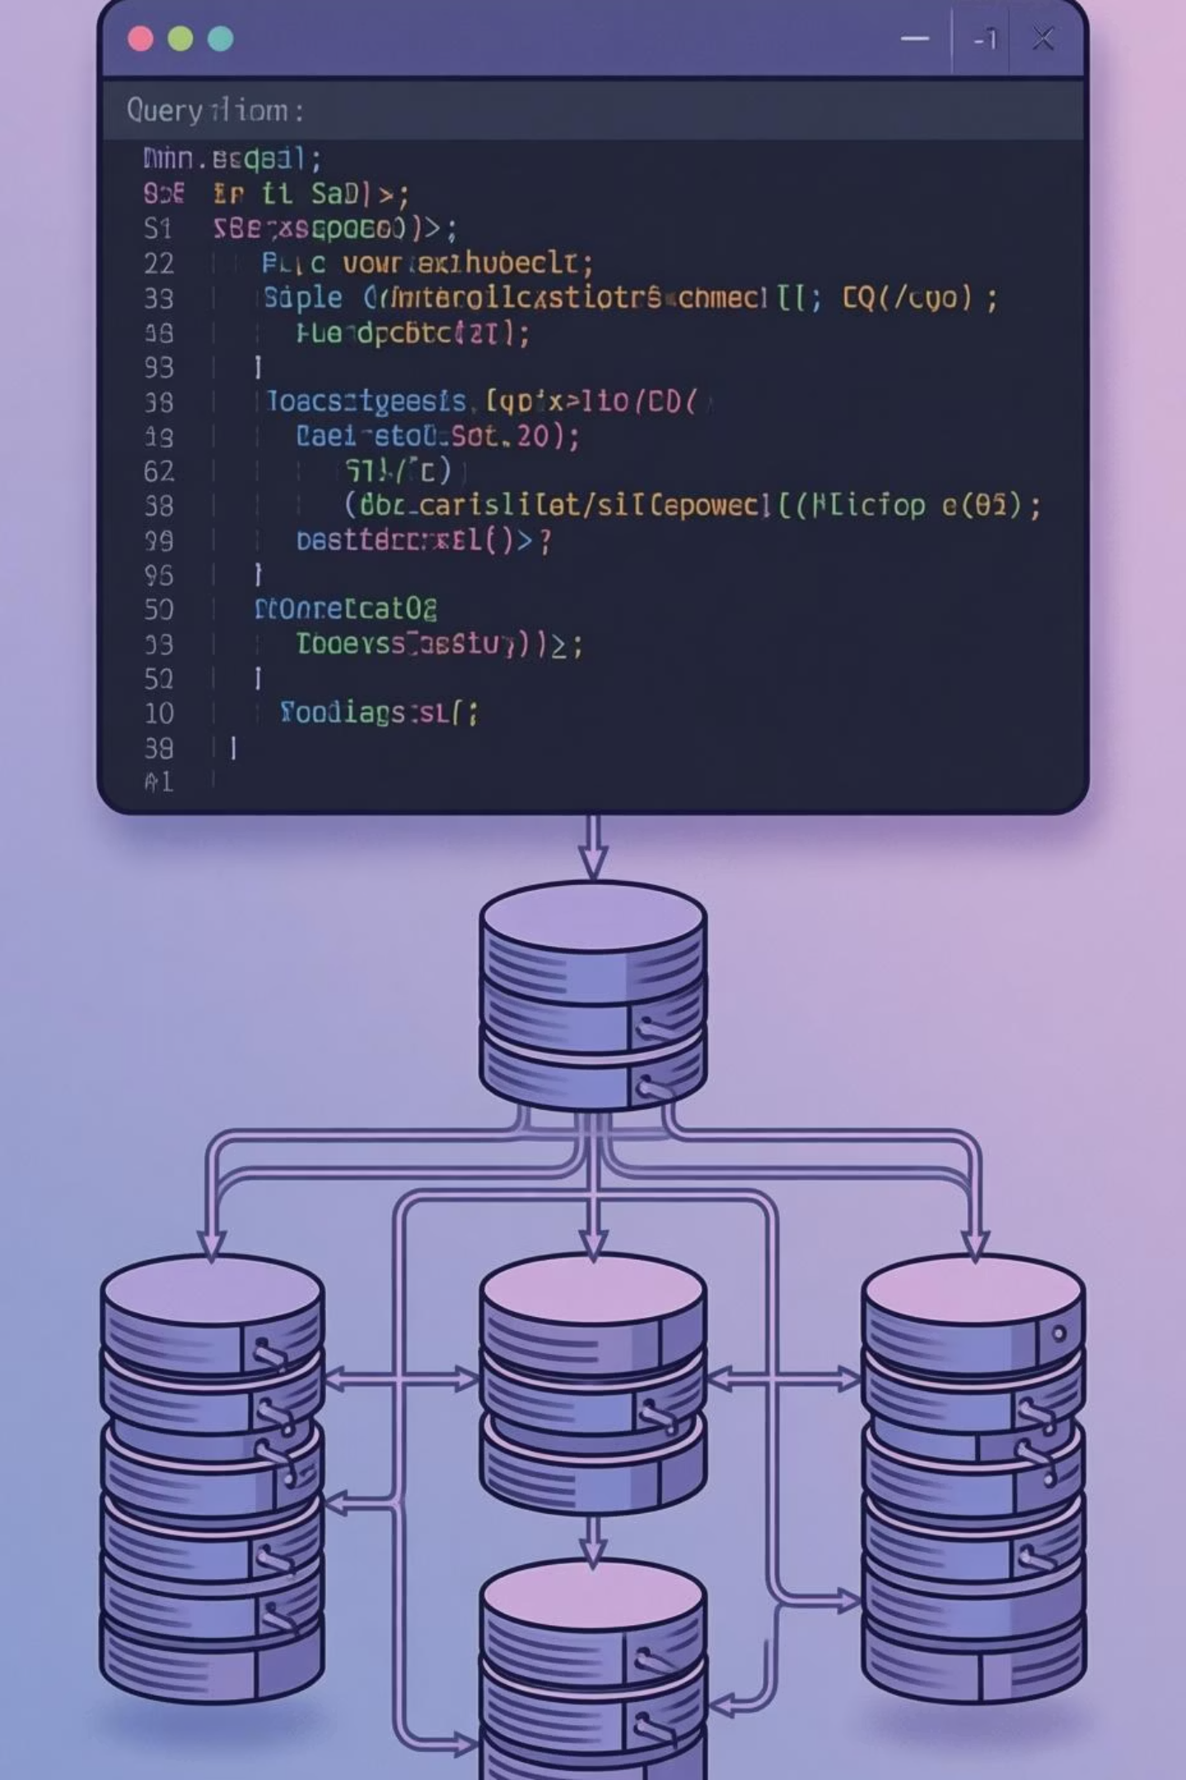
Data Analysis (SQL)
Revenue by Gender
Female: $75,191 | Male: $157,890
High-Spending Discount Users
Identified 839 customers.
Top 5 Products by Rating
Gloves (3.86), Sandals (3.84), Boots (3.82), Hat (3.80), Skirt (3.78)
Shipping Type Comparison
Standard: $58.46 | Express: $60.48

Slide 6
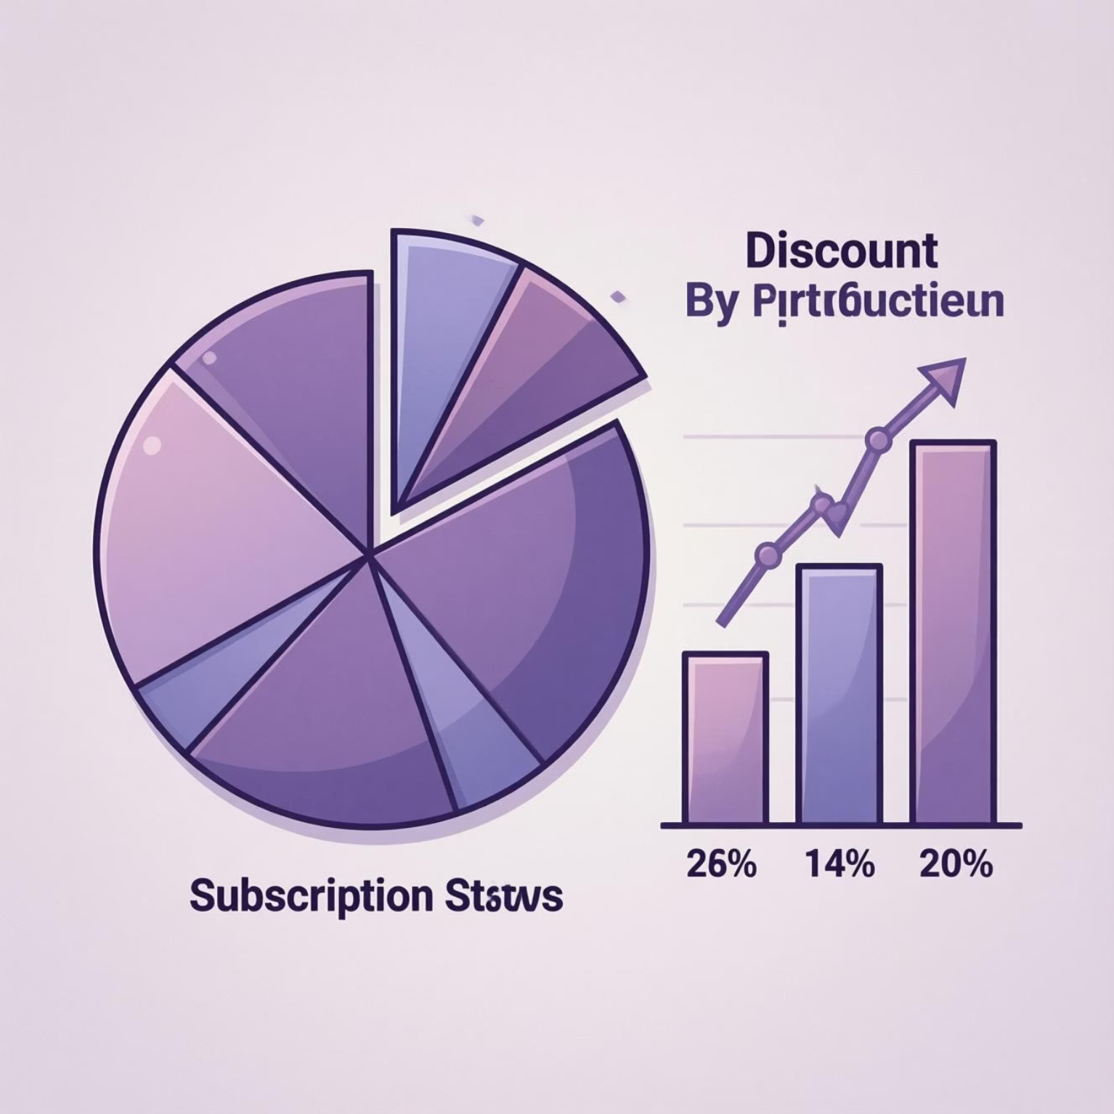
SQL Insights: Subscriptions & Discounts
Subscribers vs. Non-Subscribers
Subscribers: 1053 customers, Avg Spend $59.49, Total Revenue $62,645
Non-Subscribers: 2847 customers, Avg Spend $59.87, Total Revenue $170,436
Discount-Dependent Products
Hat (50%), Sneakers (49.66%), Coat (49.07%), Sweater (48.17%), Pants (47.37%)

Slide 7
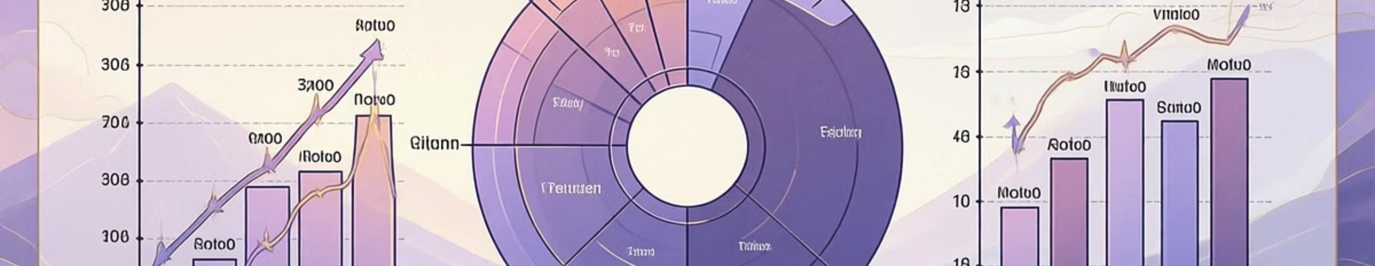
Customer Segmentation & Revenue
1
2
3
Customer Segments
Repeat Buyers & Subscriptions
Revenue by Age Group
Loyal: 3116, New: 83, Returning: 701
Young Adult: $62,143, Middle-aged: $59,197, Adult: $55,978, Senior: $55,763
No: 2518, Yes: 958

Slide 8
Top Products by Category
1
Accessories
Jewelry
171
1
Clothing
Blouse
171
1
Footwear
Sandals
160
1
Outerwear
Jacket
163

Slide 9
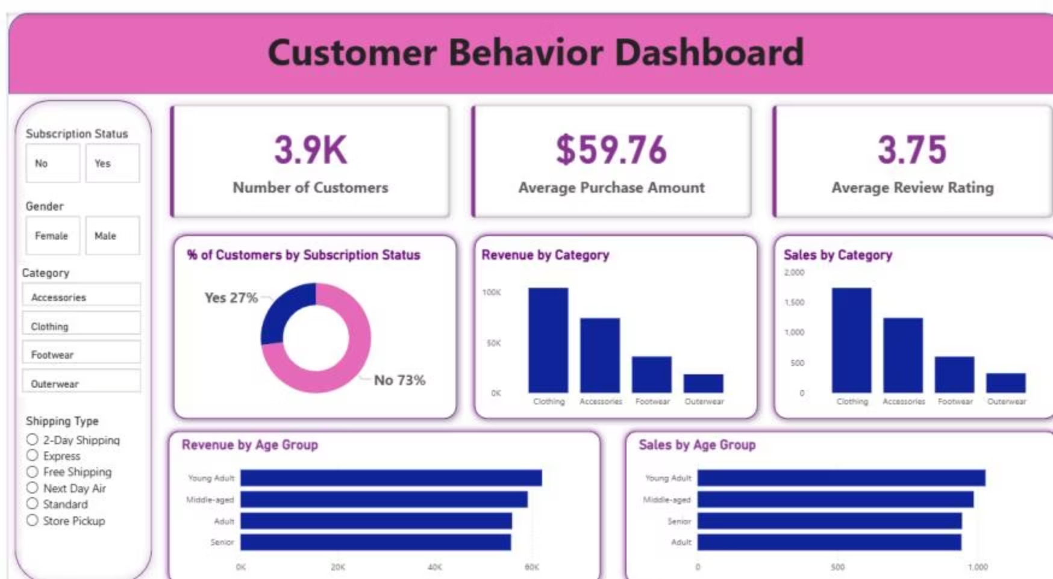

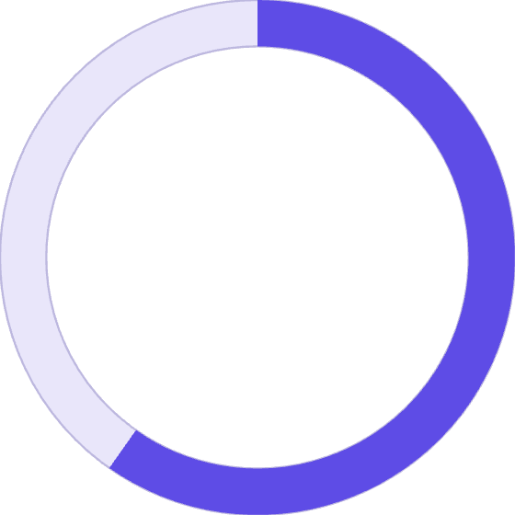

Power BI Dashboard
Interactive dashboard for visual insights.
3.9K
$59.76
3.75
Customers
Avg. Purchase
Avg. Review

Slide 10

Business Recommendations
Boost Subscriptions
Promote exclusive benefits.
Customer Loyalty Programs
Reward repeat buyers.
Review Discount Policy
Balance sales with margin control.
Product Positioning
Highlight top-rated products.
Targeted Marketing
Focus on high-revenue age groups.

